Slide 1
Deep Reinforcement Learning (DRL) Framework for Reservoir Management
Shubhendu Singh

Slide 2
Correlation Among Data samples from USBR Navajo Webportal
Correlation (Pearson) | Elevation (ft) | Storage (af) | Evaporation(af) | Inflow ** (cfs) | Total Release (cfs)
Elevation (ft) | 1.0000 | 0.954385 | 0.423944 | 0.142041 | 0.176639
Storage (af) | 0.954385 | 1.0000 | 0.467485 | 0.176525 | 0.218124
Evaporation (af) | 0.423944 | 0.467485 | 1.0000 | 0.464661 | 0.300605
Inflow ** (cfs) | 0.142041 | 0.176525 | 0.464661 | 1.0000 | 0.562441
Total Release (cfs) | 0.176339 | 0.218124 | 0.300605 | 0.562441 | 1.0000

Slide 3
Reward Functions
Reward # 1 : Non-linear High Penalty
error = abs(target_release_scaled - release_scaled)
reward=-np.square(error)
Reward # 2: Proximity to a Target Range (Constrained)
acceptable_range=0.01*target_release_scaled
error = abs(target_release_scaled - release_scaled)
if error<=acceptable_range:
reward=1.0
else:
reward=-np.square(error)
Notes:
Be a bit relaxed initially. Be more permissible. Start with some moderate epochs

Slide 4
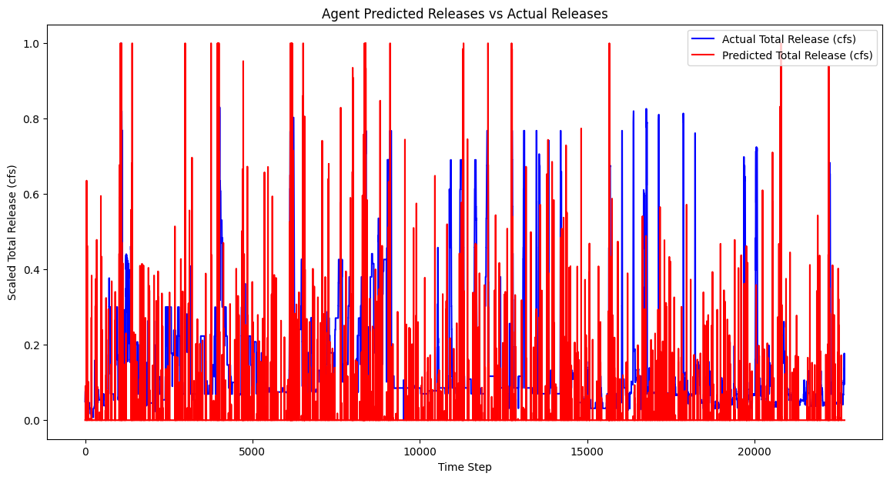
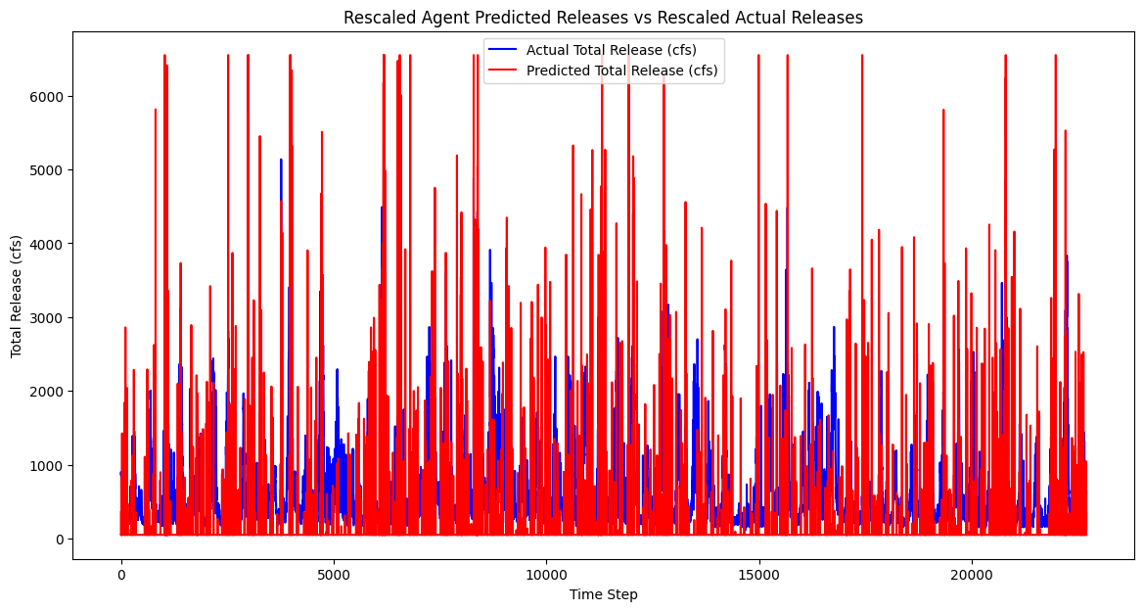
Proximal Policy Optimization (PPO) Agent: Non-Linear Reward
Mean Squared Error (MSE) : 0.043231
Root Mean Squared Error (RMSE) : 0.2079
Mean Absolute Error (MAE) : 0.01435
Mean Squared Error (MSE) : 727178.62800
Root Mean Squared Error (RMSE) : 852.74769
Mean Absolute Error (MAE) : 608.6511

Slide 5
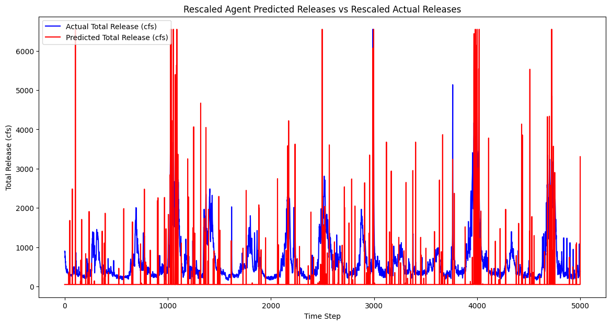
Proximal Policy Optimization (PPO) Agent: Non-Linear Reward

Slide 6
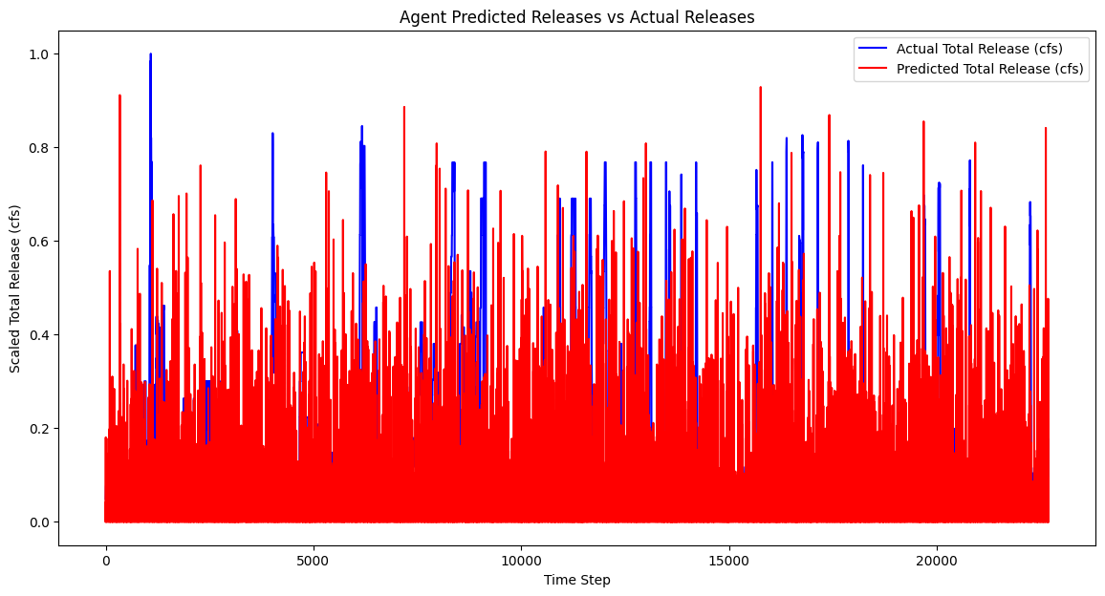
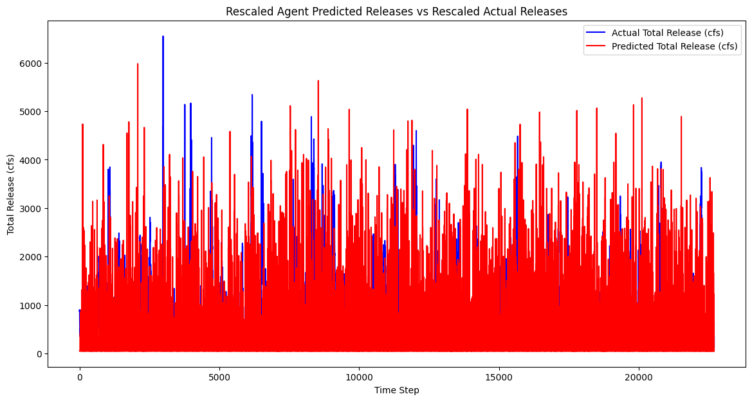
Proximal Policy Optimization (PPO) Agent- Reward Based on Proximity to a Target Range
Mean Squared Error (MSE) : 0.034
Root Mean Squared Error (RMSE) : 0.18439
Mean Absolute Error (MAE) : 0.0123
Mean Squared Error (MSE) : 616214.62800
Root Mean Squared Error (RMSE) : 784.993
Mean Absolute Error (MAE) : 512.5311

Slide 7
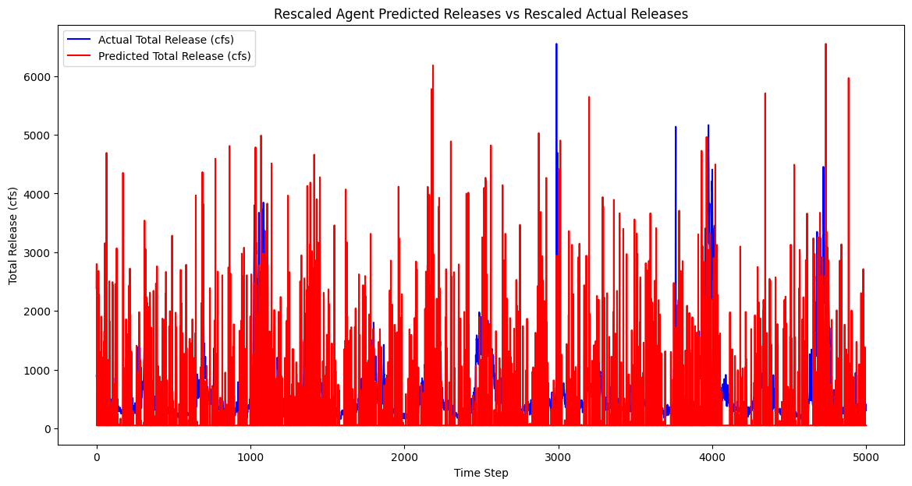
Proximal Policy Optimization (PPO) Agent- Reward Based on Proximity to a Target Range

Slide 8
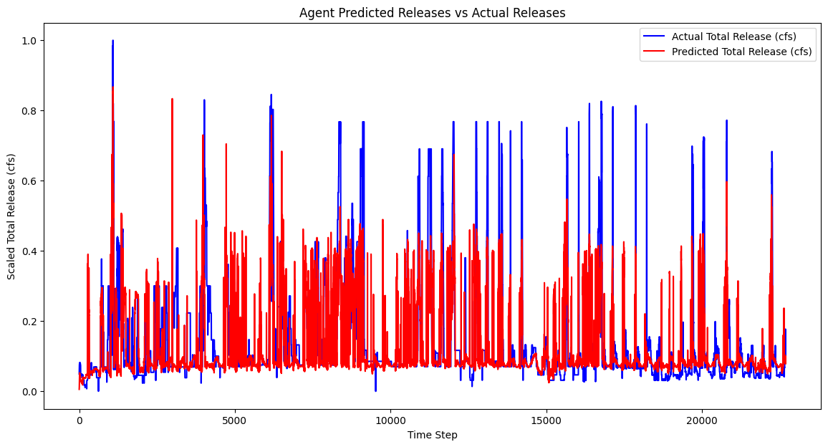
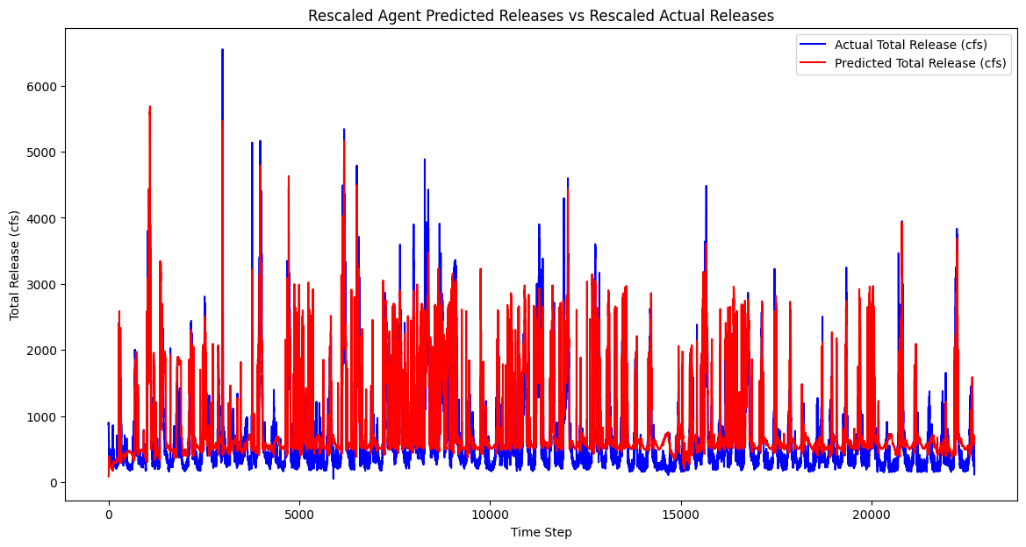
Twin-Delayed Deep Deterministic (TD3) Policy Gradient Agent
Mean Squared Error (MSE) : 0.01685166
Root Mean Squared Error (RMSE) : 0.1298139501
Mean Absolute Error (MAE) : 0.0091343
Mean Squared Error (MSE) : 174164.1626
Root Mean Squared Error (RMSE) : 417.3298
Mean Absolute Error (MAE) : 301.518662

Slide 9
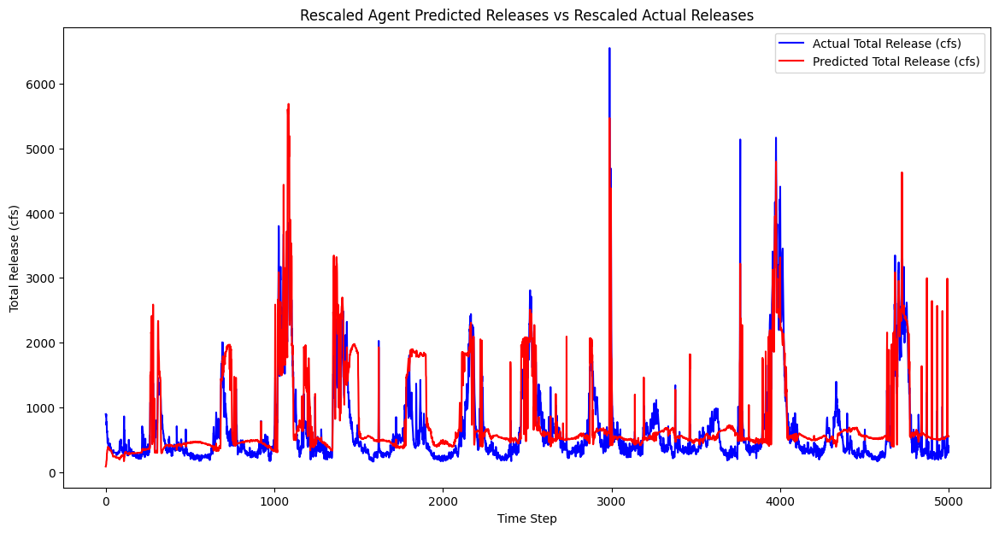
Twin-Delayed Deep Deterministic (TD3) Policy Gradient Agent

Slide 10
To do List
Red – Not Working
Orange – Work in Progress
Green – Completed
No Color- Not Attempted
Use date as a token to guide the training of the agent
Use more advanced non-linear polynomial and proximity reward functions
Further improve the performance of the TD3 agent
Explore other RL agents apt for continuous state-action space
Integration of streamflow, evaporation model
Use previous days release as feature- used in reward function, will use as feature too
Forecasted release

Slide 11
Reward Functions
Reward # 3: Penalty for large changes in release (Smoothness Constrained)
deviation_penalty = np.square(release_scaled - target_release_scaled)
if self.current_step >=0:
smoothness_penalty = np.square(release_scaled - prev_release_scaled)
else:
smoothness_penalty = 0
reward= - deviation_penalty - 0.15 * smoothness_penalty

Slide 12
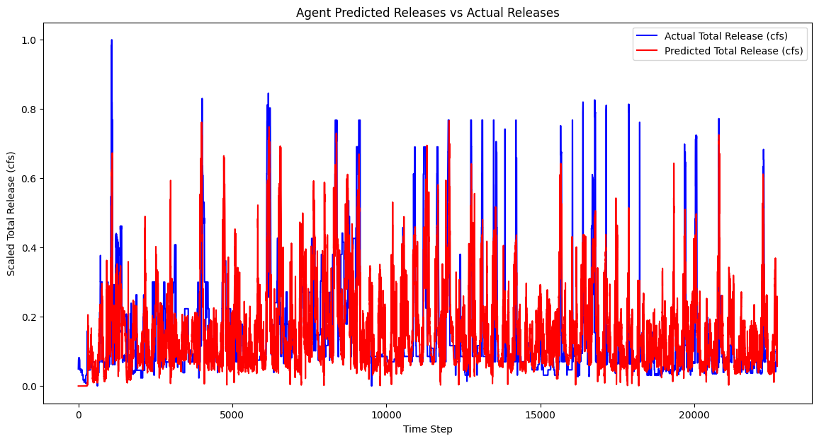
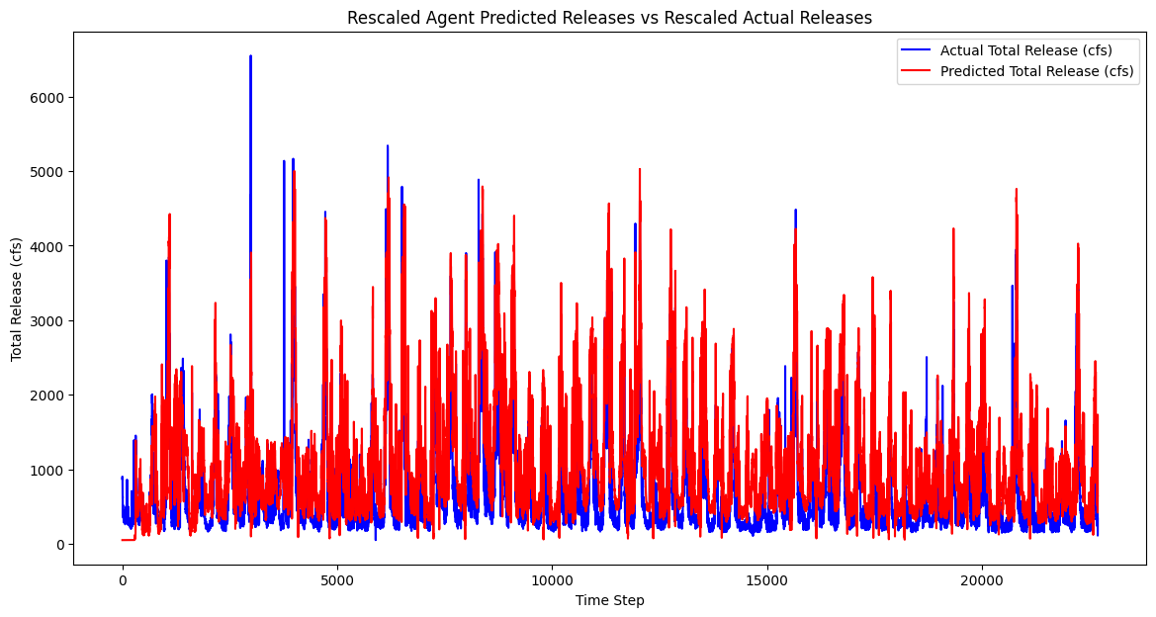
TD3 Policy Gradient Agent - Reward #3
Mean Squared Error (MSE) : 0.01435
Root Mean Squared Error (RMSE) : 0.11979
Mean Absolute Error (MAE) : 0.008127366
Mean Squared Error (MSE) : 133512.26688
Root Mean Squared Error (RMSE) : 365.3933
Mean Absolute Error (MAE) : 273.219536

Slide 13
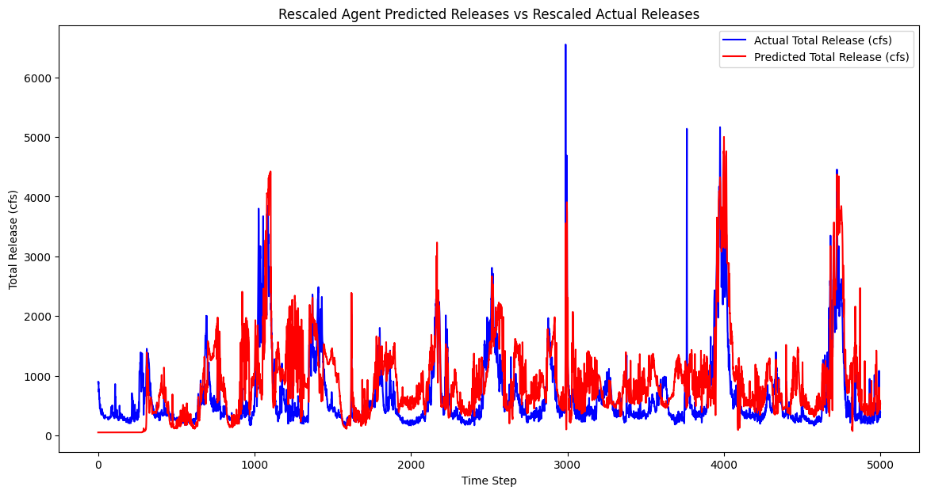
TD3 Policy Gradient Agent - Reward #3

Slide 14
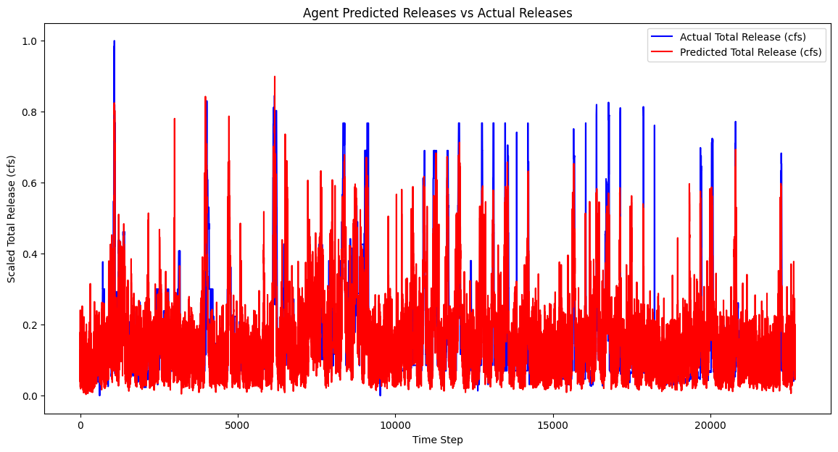
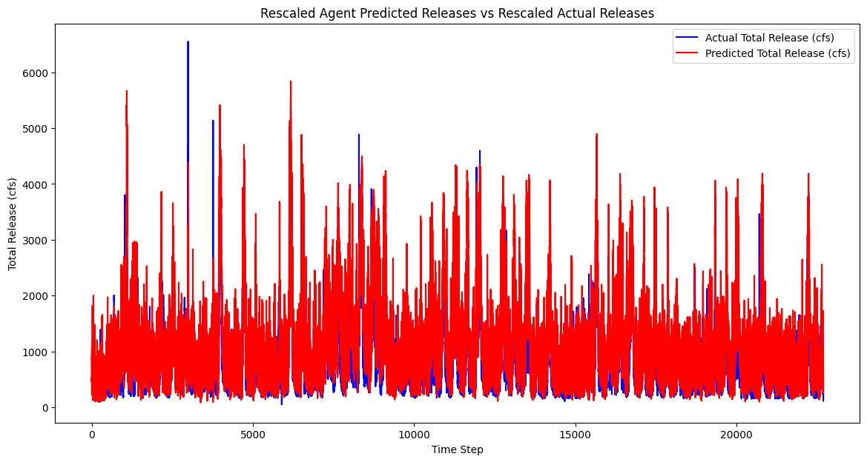
Soft Actor-Critic (SAC) Agent - Reward #3
Mean Squared Error (MSE) : 0.015582
Root Mean Squared Error (RMSE) : 0.1248
Mean Absolute Error (MAE) : 0.009756
Mean Squared Error (MSE) : 387935.14324
Root Mean Squared Error (RMSE) : 622.844397
Mean Absolute Error (MAE) : 482.3750

Slide 15
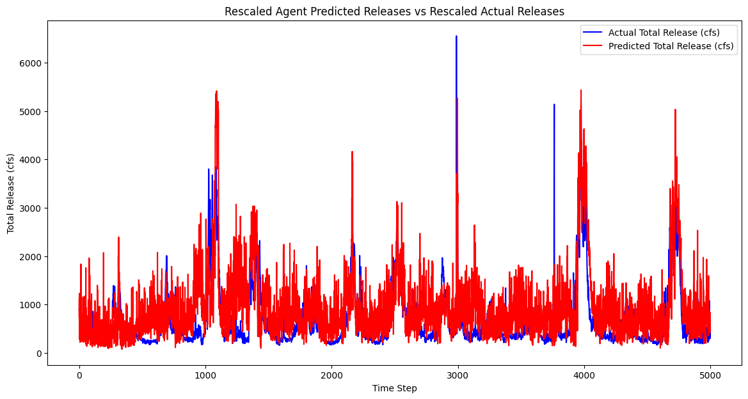
Soft Actor-Critic (SAC) Agent - Reward #3

Slide 16


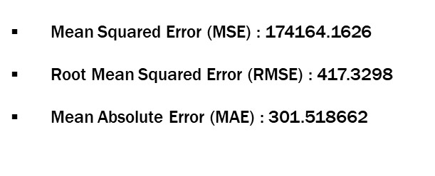
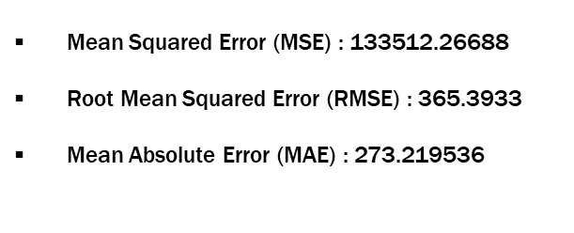
Comparison- TD3 (Reward#2) & TD3 (Reward#3)
TD3 (Reward#2)
TD3 (Reward#3)

Slide 17

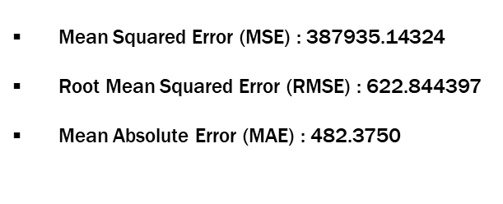
Comparison- SAC (Reward#3) & TD3 (Reward#3)
SAC (Reward#3)
TD3 (Reward#3)

Slide 18
To do List
Red – Not Working
Orange – Work in Progress
Green – Completed
No Color- Not Attempted
Forecasted Release
Use previous days release as feature- used in reward function, will use as feature too
Use more advanced non-linear polynomial and proximity reward functions
Further improve the performance of the TD3 agent, and explore other RL agents
Explore an ensemble of agents for prediction of release, and use LSTM policy
Integration of streamflow, evaporation model

Slide 19
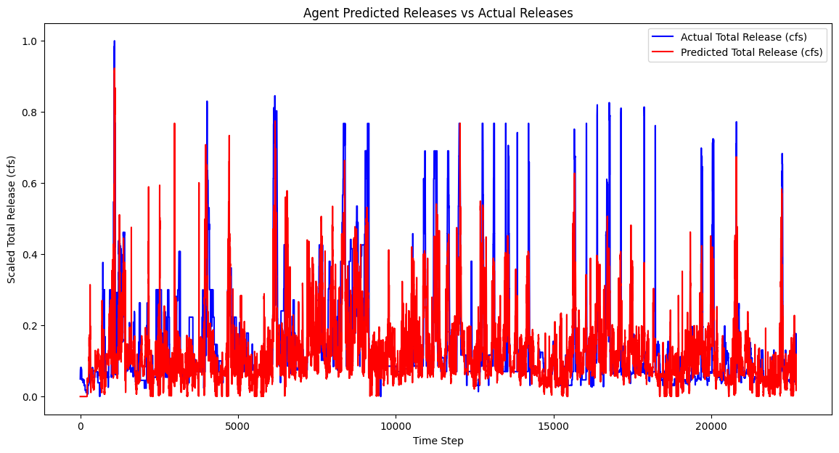
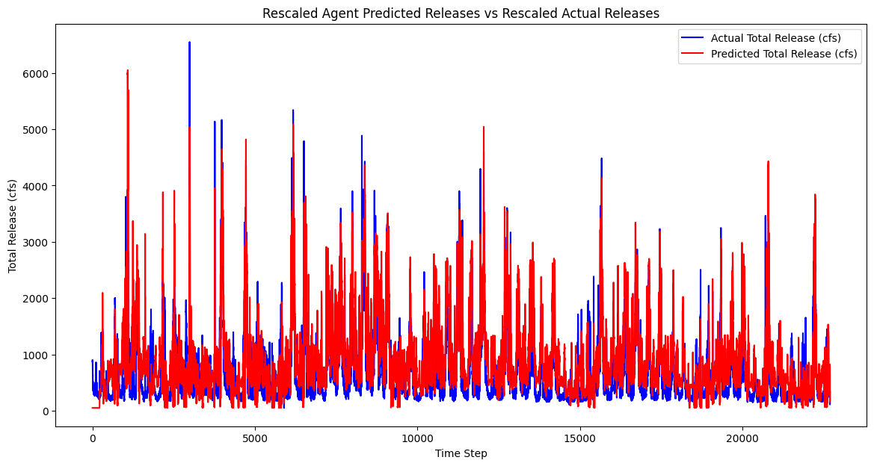
TD3 Policy Gradient Agent - Reward #3 (3 Days of Look Back)
Mean Squared Error (MSE) : 0.01027
Root Mean Squared Error (RMSE) : 0.10134
Mean Absolute Error (MAE) : 0.00739
Mean Squared Error (MSE) : 99679.325
Root Mean Squared Error (RMSE) : 315.720327
Mean Absolute Error (MAE) : 213.65674

Slide 20
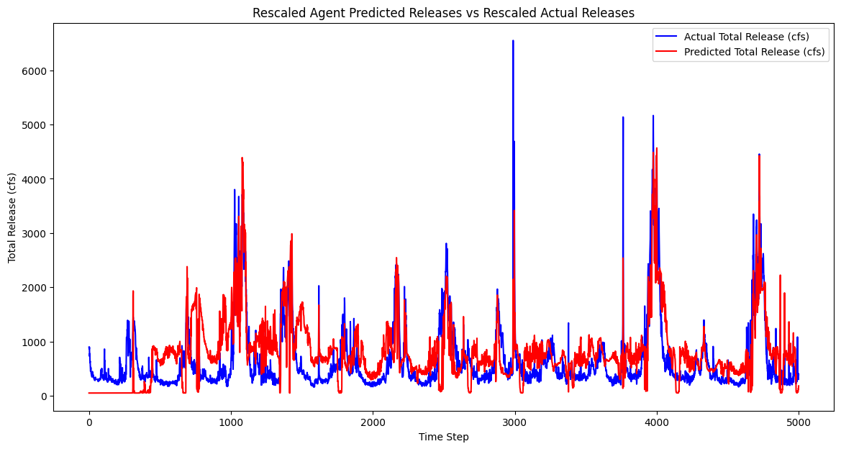
TD3 Policy Gradient Agent - Reward #3 (3 Days of Look Back)

Slide 21
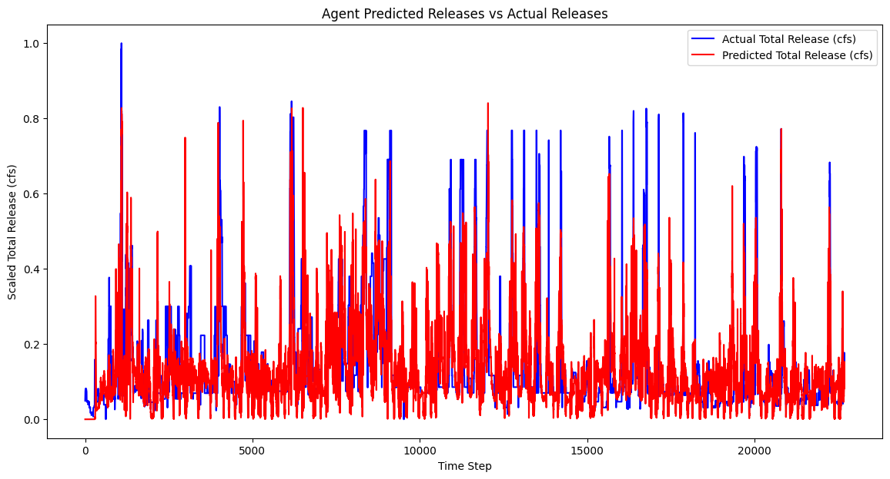
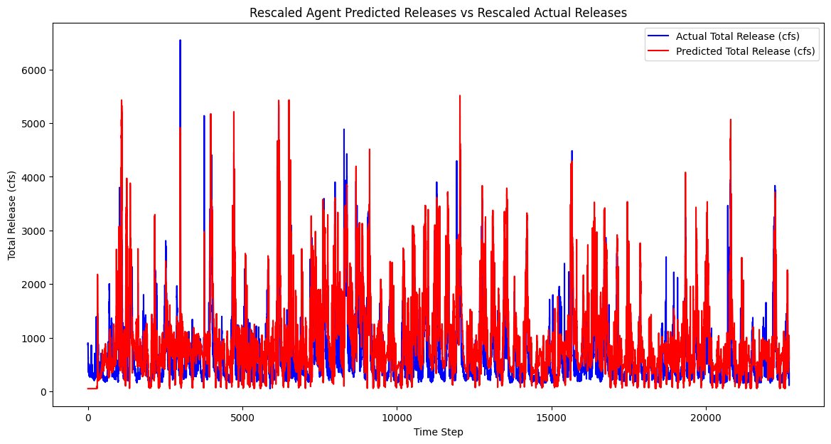
TD3 Policy Gradient Agent - Reward #3 (7 Days of Look Back)
Mean Squared Error (MSE) : 0.01279
Root Mean Squared Error (RMSE) : 0.11309
Mean Absolute Error (MAE) : 0.0080645
Mean Squared Error (MSE) : 119111. 2499
Root Mean Squared Error (RMSE) : 345.1249
Mean Absolute Error (MAE) : 239.8585

Slide 22
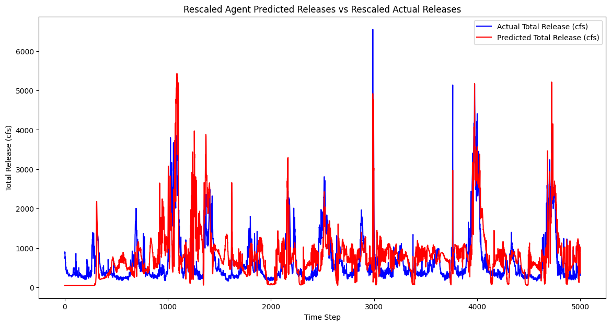
TD3 Policy Gradient Agent - Reward #3 (7 Days of Look Back)

Slide 23
Comparison TD3 Agent- Reward#3 (Look back period-1,3, & 7 days)
TD3 (Reward#3) - 1 Day, MSE: 133512.26688
TD3 (Reward#3) - 3 Day, MSE: 99679.325
TD3 (Reward#3) - 7 Day, MSE: 119111.2499

Slide 24
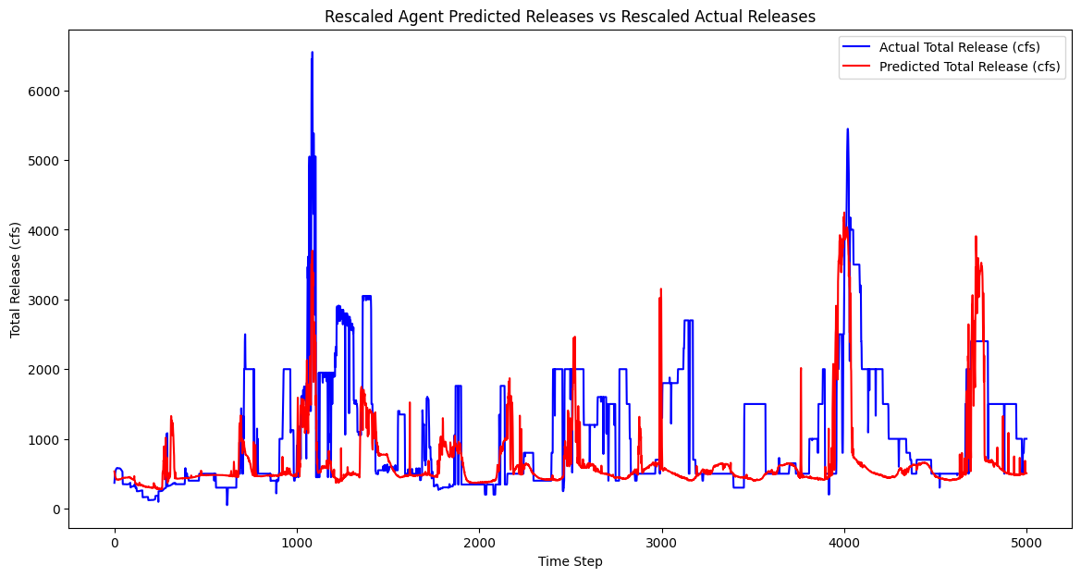
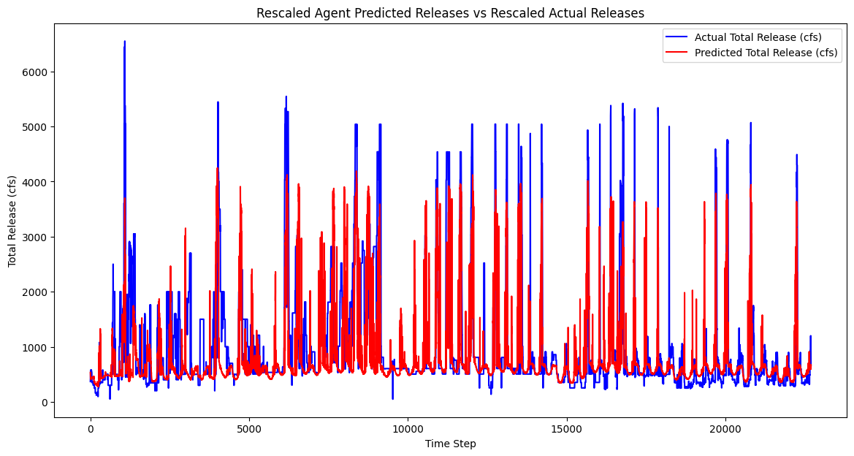
TD3 Ensemble Model- Reward # 2 (Work in Progress)
Mean Squared Error (MSE) : 470201.0326
Root Mean Squared Error (RMSE) : 685.712
Mean Absolute Error (MAE) : 354.3675

Slide 25
Comparative Findings: PPO, TD3, SAC Agents (MSE for Rescaled Values)
Mean Squared Error (MSE) | Reward # 1 (Non-linear) | Reward # 2 ( Proximity to target) | Reward # 3 (Penalty for large changes in release, look back period)
PPO | 727178.62800 | 616214.62800 | -
SAC | - | - | 387935.14324
TD3 | - | 174164.1626 | -
TD3 (1 day look back) | - | - | 133512.26688
TD3 (3 day look back) | - | - | 99679.325
TD3 ( 7 day look back) | - | - | 119111.2499
TD3 Ensemble (Work in Progress) | - | 470201.0326 | Work in Progress

Slide 26
Reward Functions
Reward # 4: Penalty for large changes in release (Smoothness Constrained)+ penalty for extreme events
deviation_penalty = np.square(release_scaled - target_release_scaled)
if self.current_step >=0:
smoothness_penalty = np.square(release_scaled - prev_release_scaled)
else:
smoothness_penalty = 0
extreme_action_penalty = np.square(max(0, release_scaled – max_release)) + np.square(max(0, min_release - release_scaled))
reward = -deviation_penalty - 0.1 * smoothness_penalty - 0.05 * extreme_action_penalty

Slide 27
To do List
Red – Not Working
Orange – Work in Progress
Green – Completed
No Color- Not Attempted
Reward # 4 Performance Analysis
Forecasted Release
Come up with other relevant metrics for performance evaluation
Integration of streamflow, evaporation model
Further improve the performance of the TD3 agent, and explore other RL agents
Use previous days release as feature- used in reward function, will use as feature too
Explore an ensemble of agents for prediction of release, and use LSTM policy

